Slide 1

Supervisor:
Dr. Russell Butler
Student:
Razieh Shahsavar
2022/July/06

Slide 2
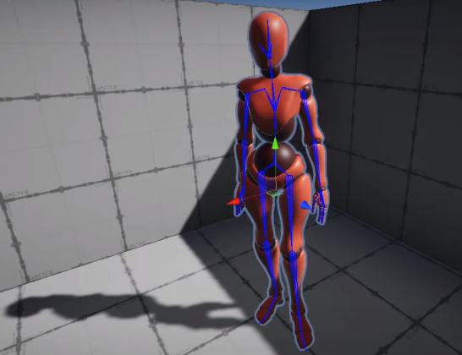
The objective of MY project
predicting animation skeleton based on 2d video input (using Deep Learning).

Slide 3

Completed steps of thesis: step 1)
Learning basic concepts of the Unity from the unity website https://unity.com/learn

Slide 4
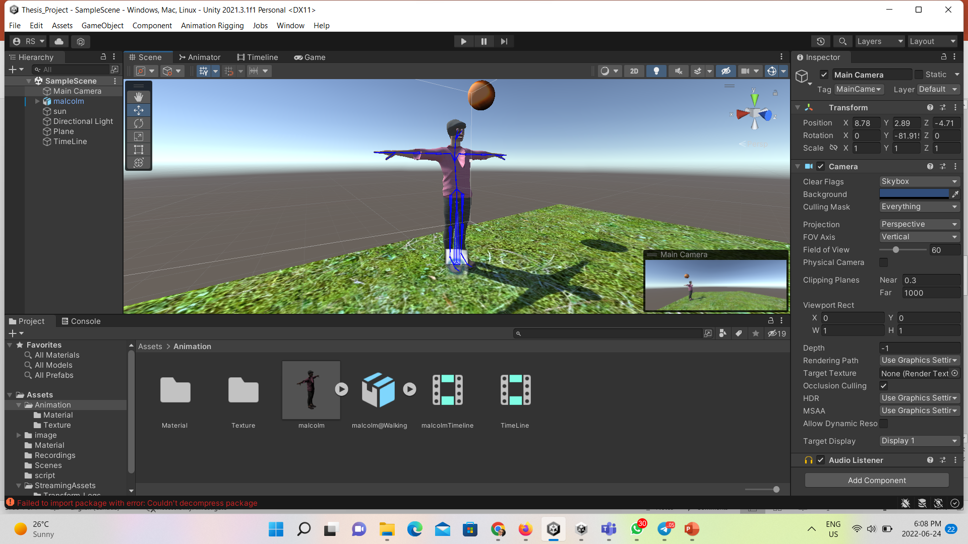
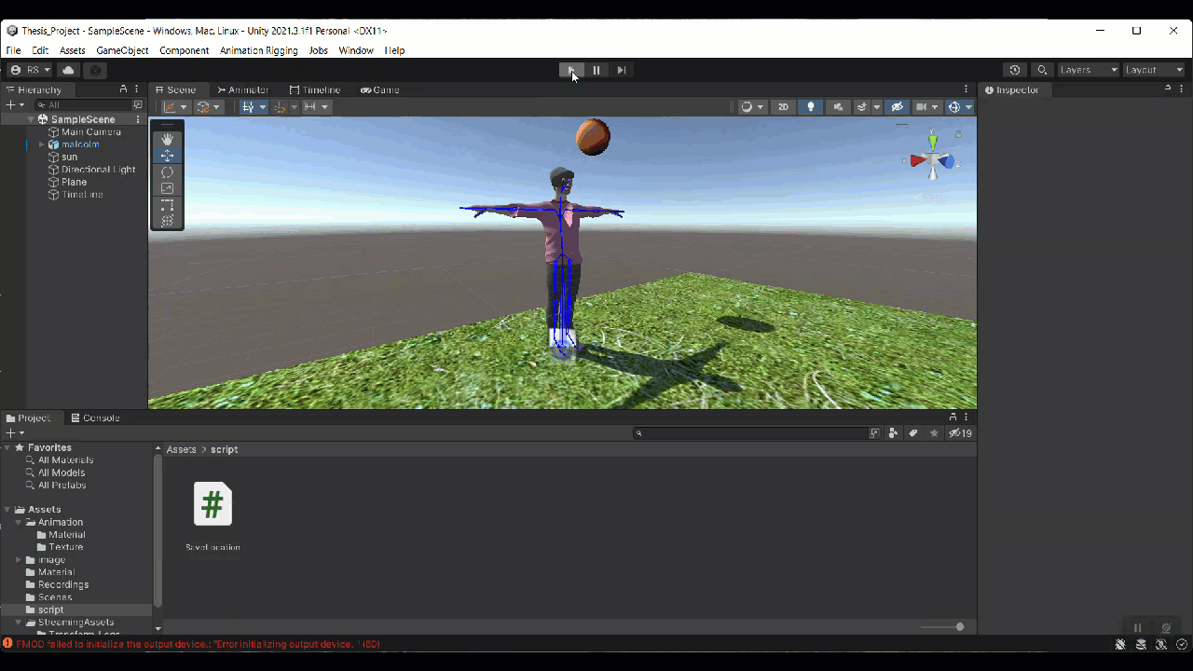
Step2)
I imported an animation into Unity and then applied the walking action to it
I modified the animation movement by Rig builder and Bone Render

Slide 5
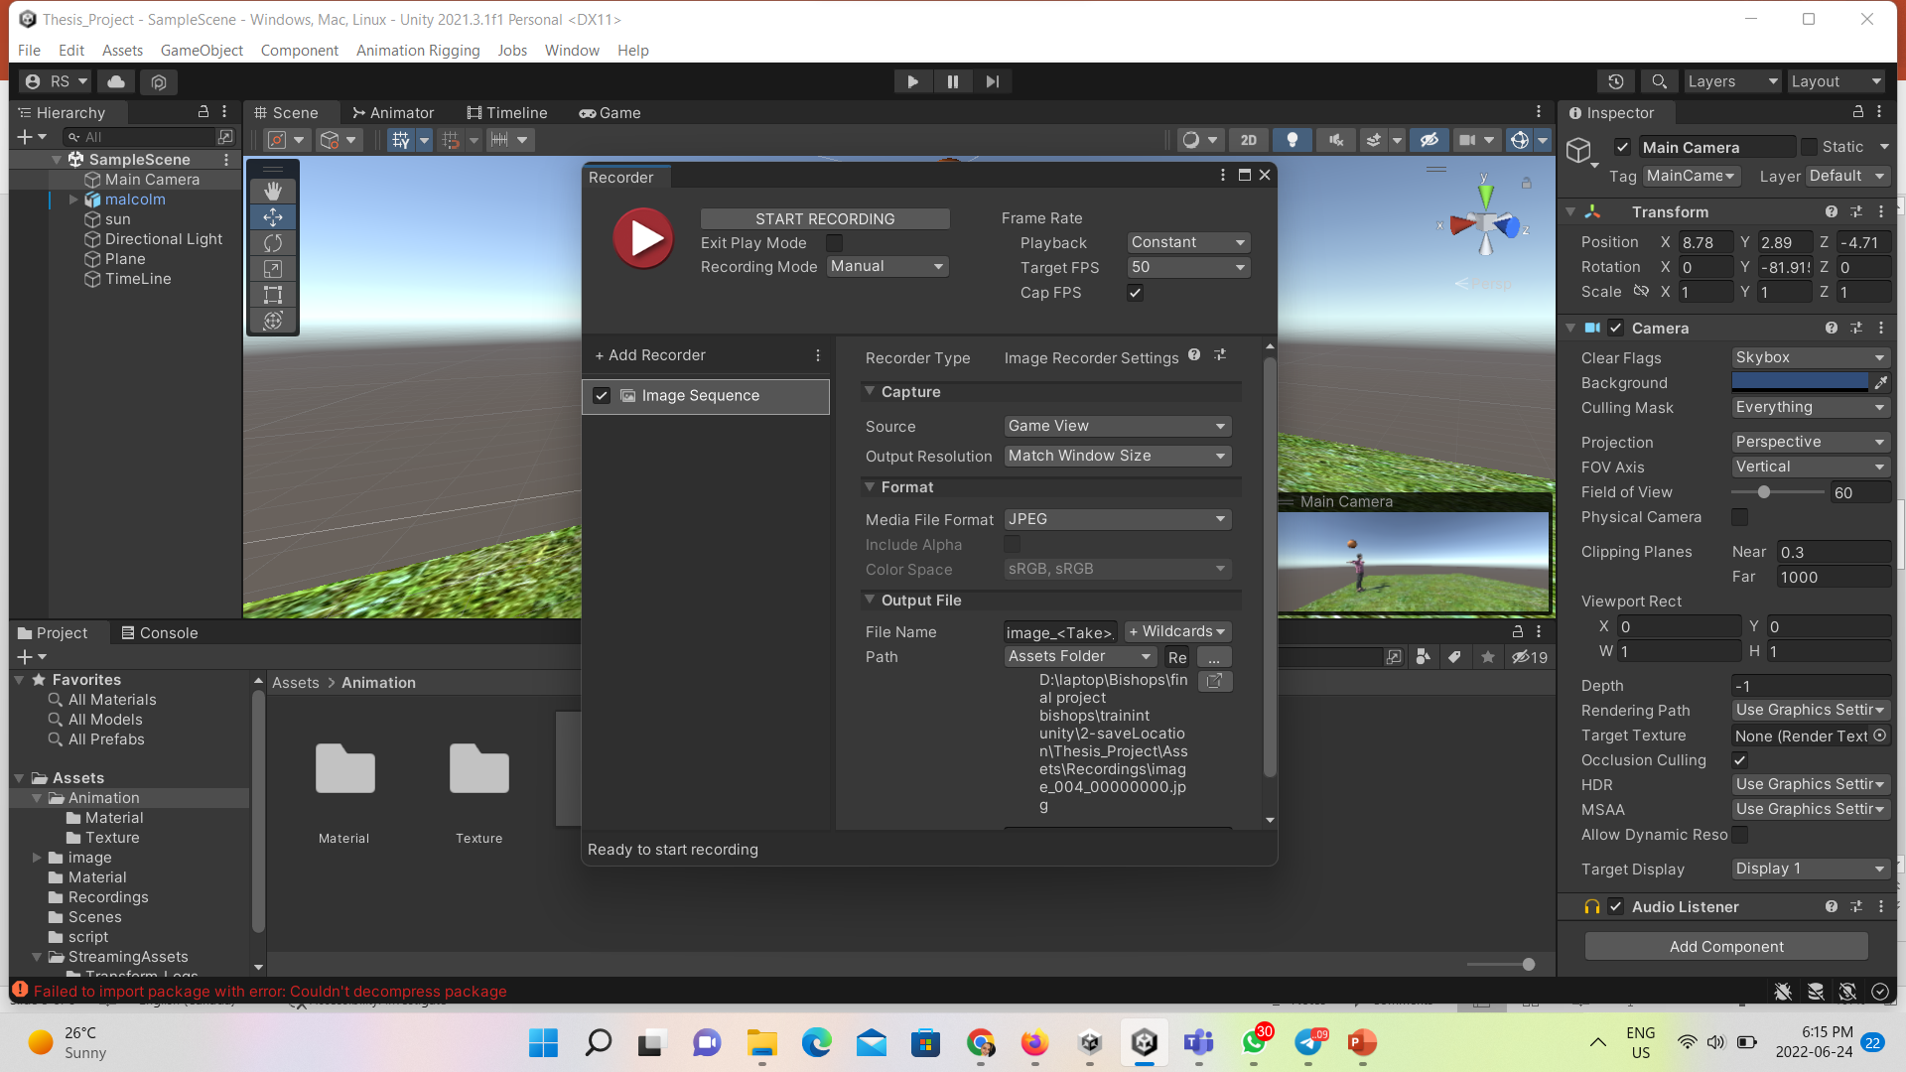
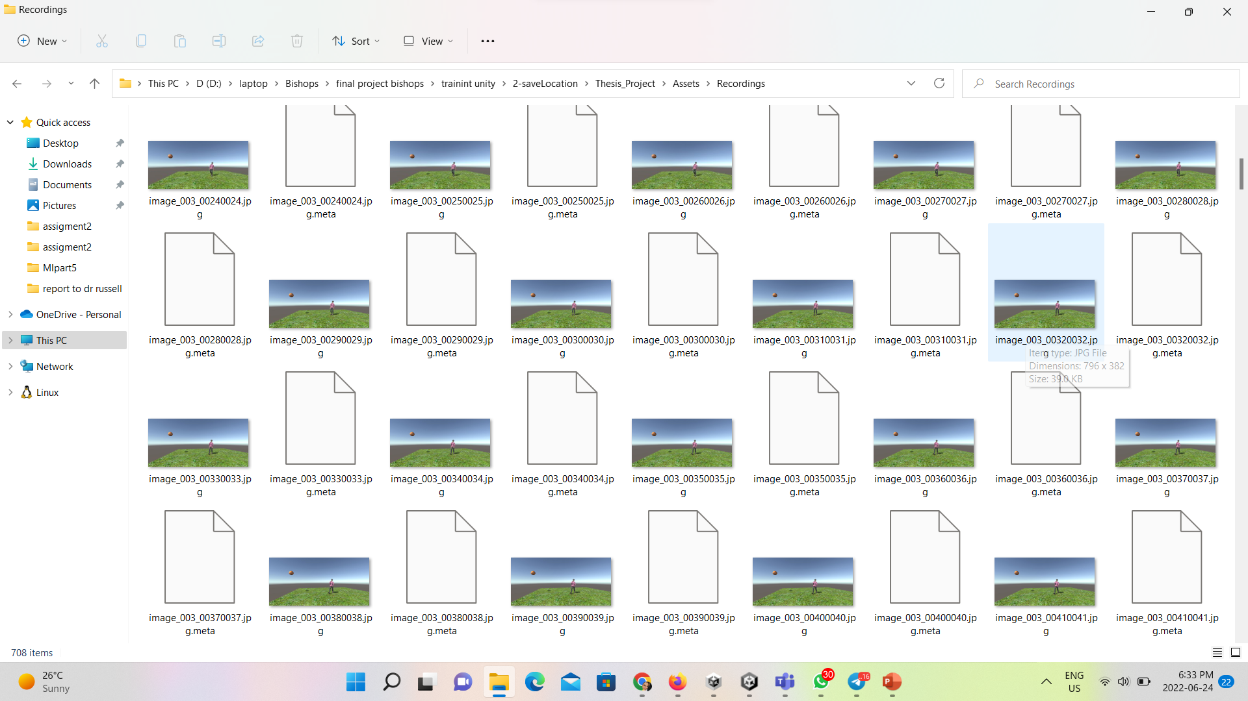
Step3)
Steps of Create Synthesis dataset:
Extract all steps of movement of animation as an image

Slide 6
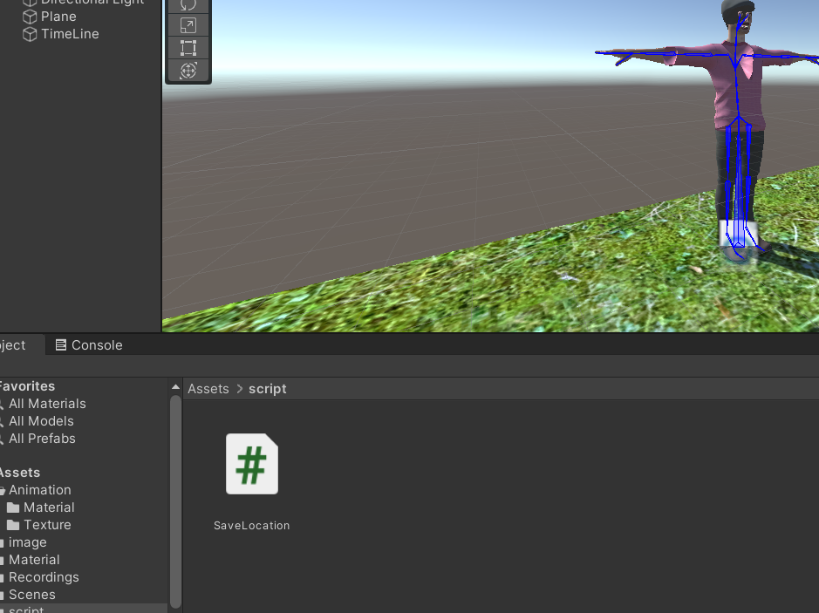
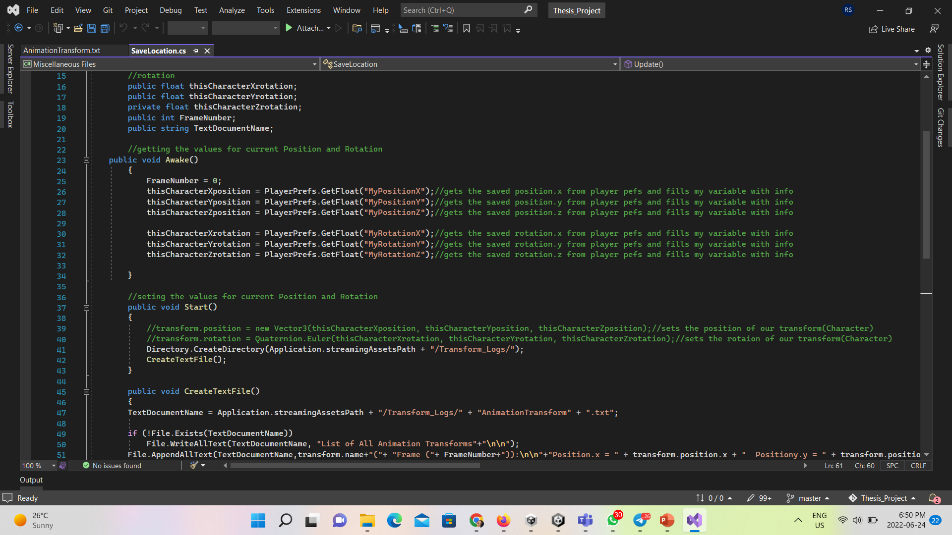
Step4)
Steps of Create Synthesis dataset:
Then Extract all coordinates of transform (position and rotation) of animation for x,y,z:
create a script in unity to write some code to extract coordinate of joints of animation by each movement of animation and save them in the text file

Slide 7
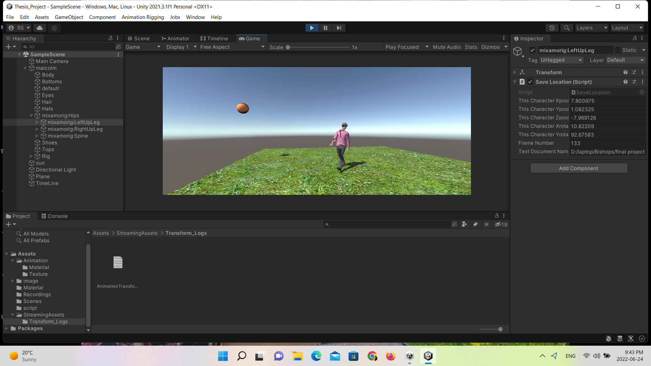
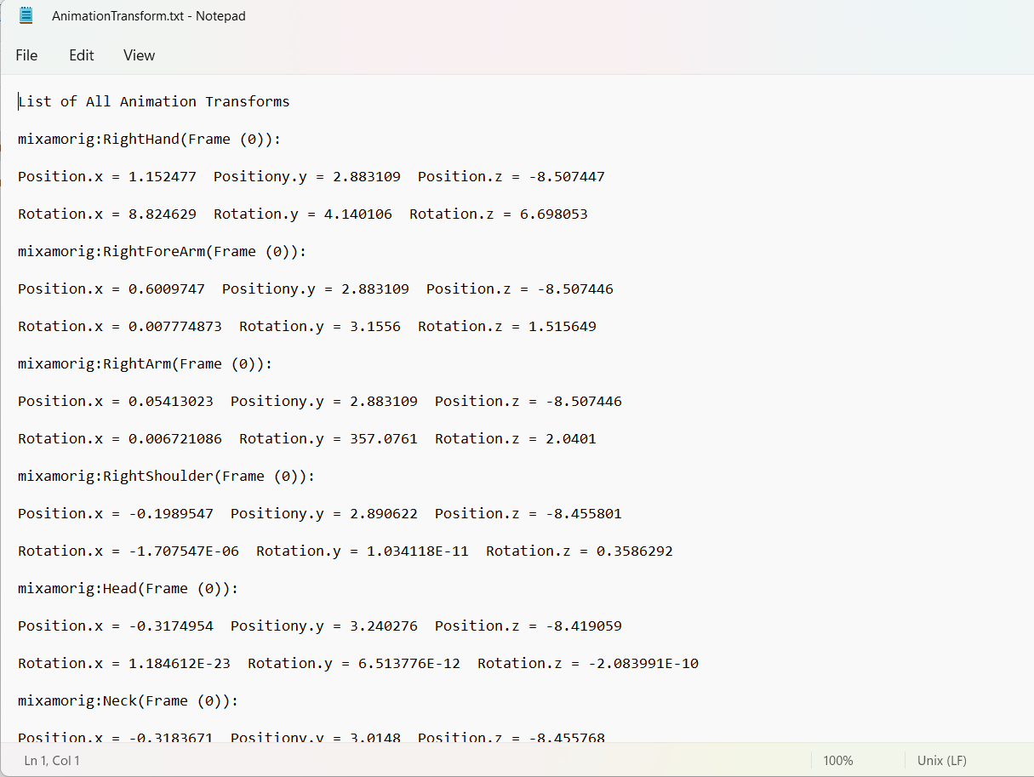
Step4)
Steps of Create Synthesis dataset:
Then Extract all coordinates of transform (position and rotation) of animation for x,y,z:
Show coordinate of movement in unity and also as a text file

Slide 8
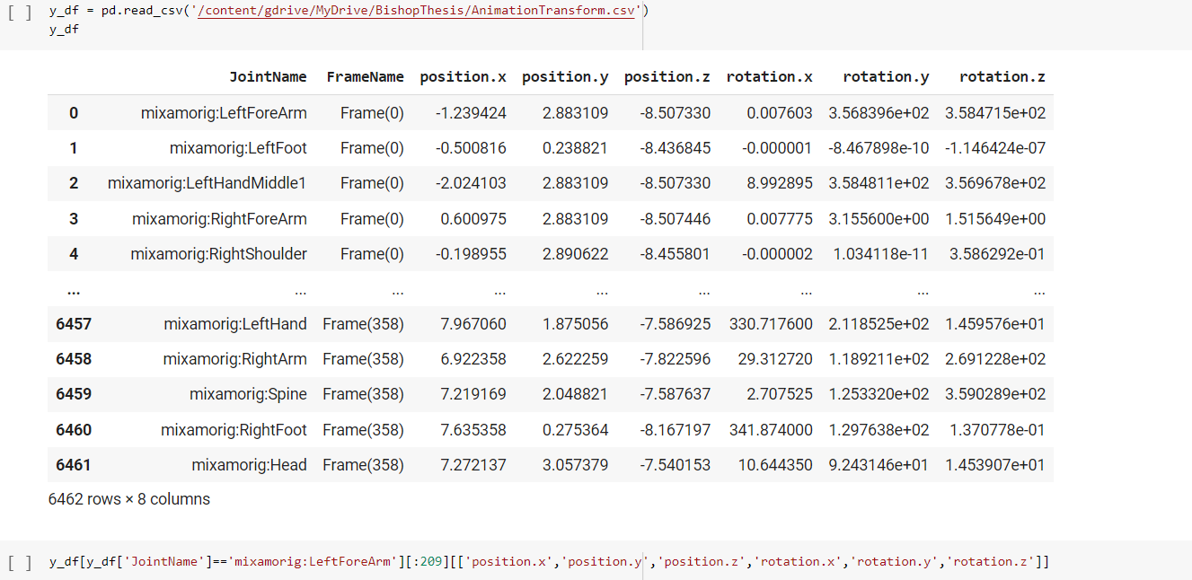
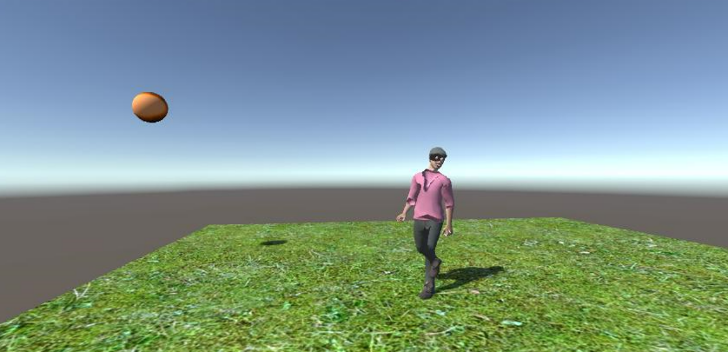
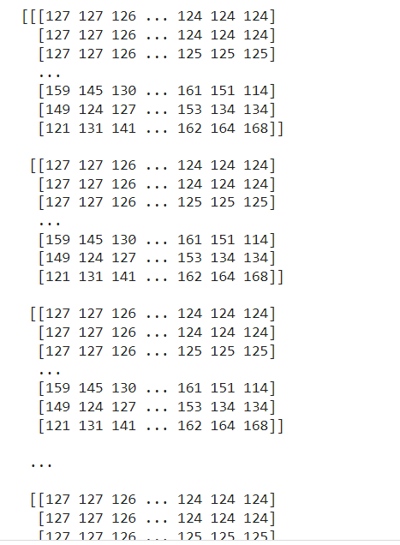
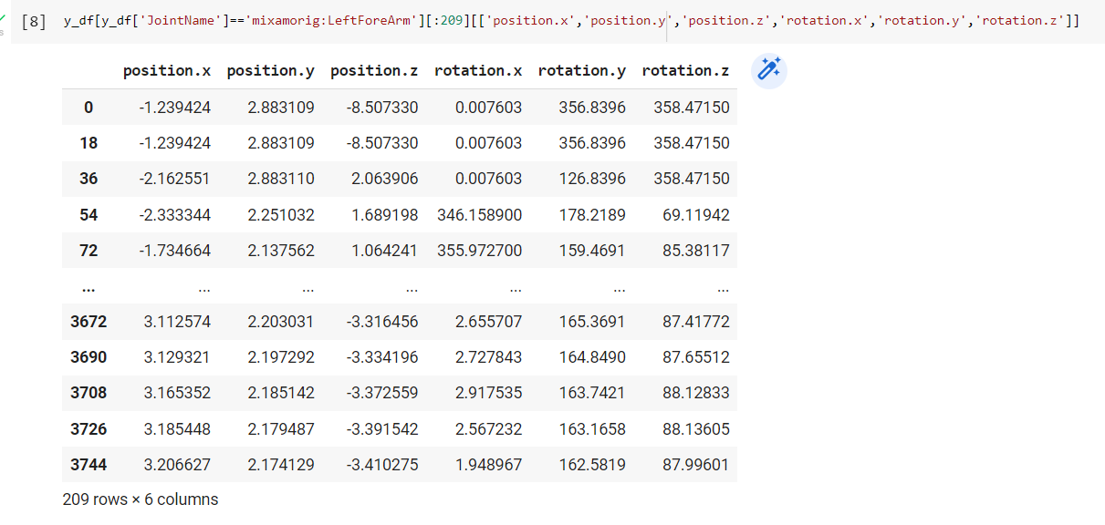
Step5)
Create train and test data to create the model for prediction:
input data=numpy array(Camera Frame) target data=transform value(position & rotation)

Slide 9
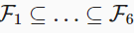
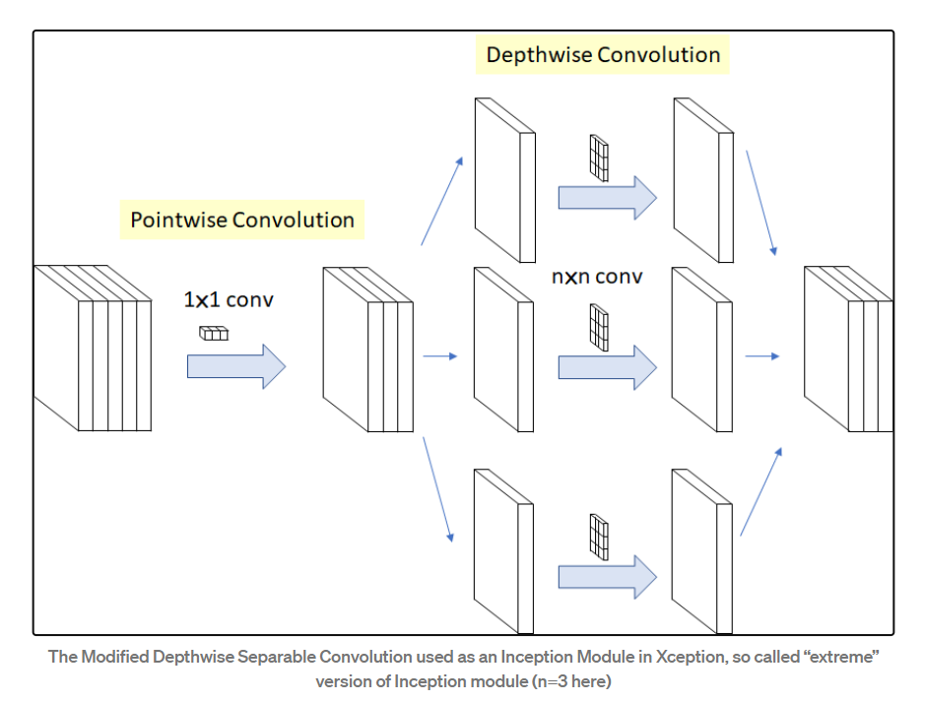
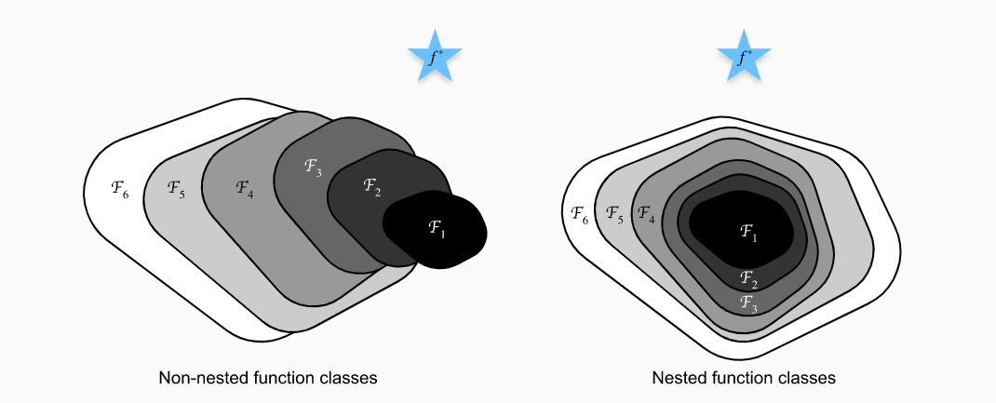
Step5)
Use pre_train model "Xception"(to Only search ResNet architectures) to predict the value of transforms of animation:
depthwise separable convolution is the pointwise convolution followed by a depthwise convolution.
for non-nested function classes, a larger function class does not always move closer to the “truth” function f* but With nested function classes where on the right of Figure we can avoid the aforementioned issue from the non-nested function classes.

Slide 10
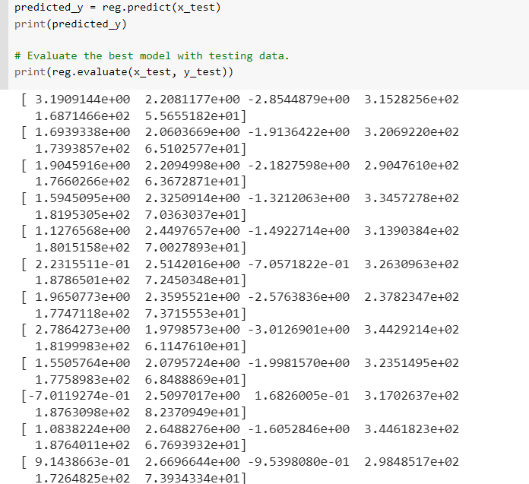
Step6)
Predict with the best model for each joint's positions and rotations.

Slide 11
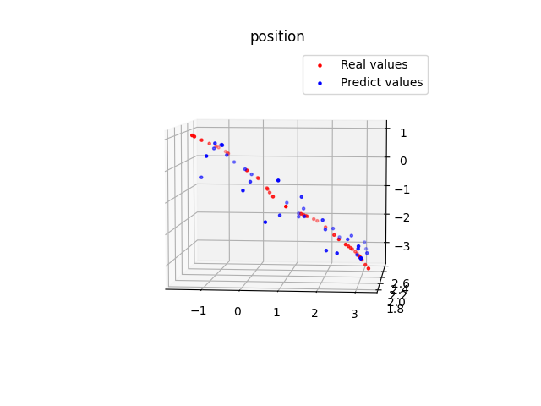
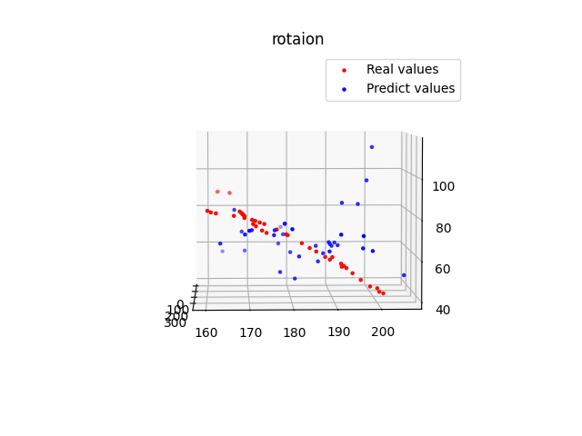
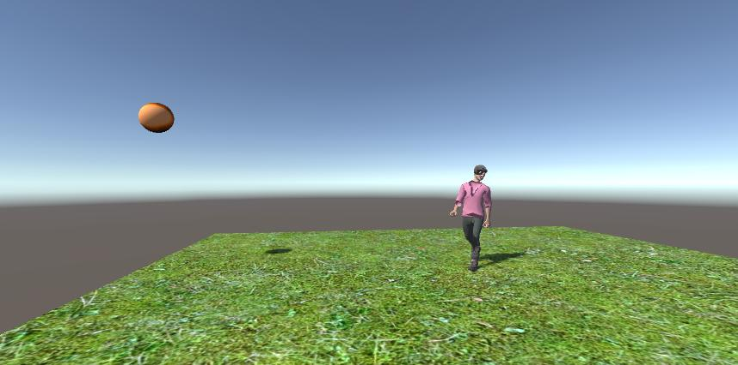
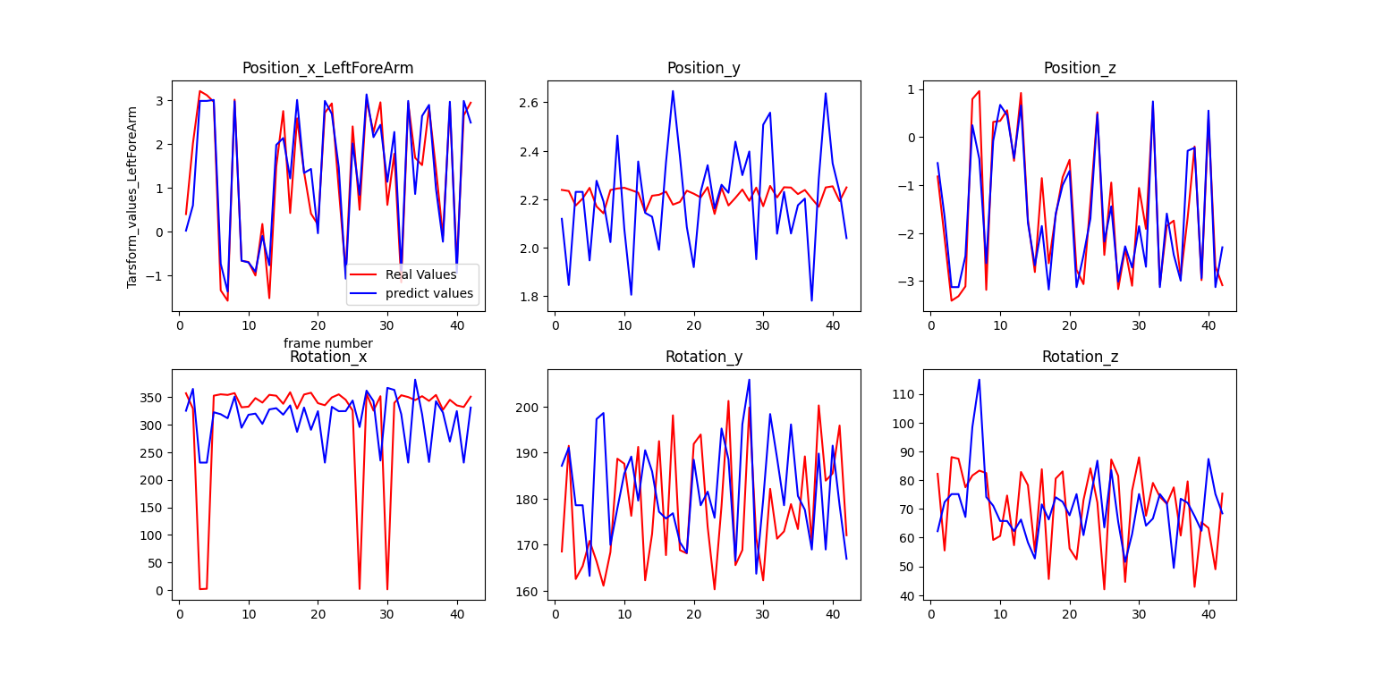
Step7)
Save the predicted value in
the csv file and feed them to
the transforms of animation in Unity

Slide 12
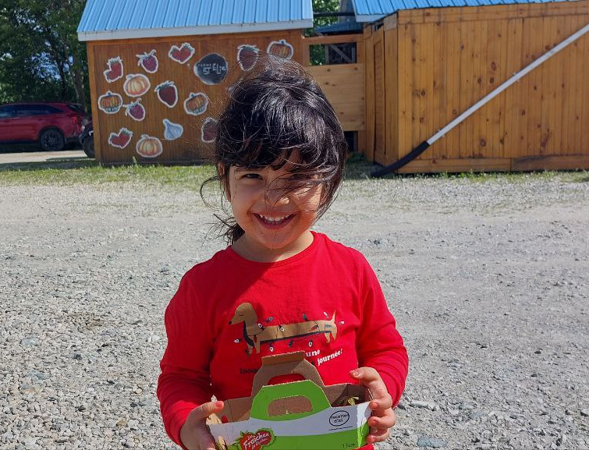
End
july 06 2022
12:00 PM

